Slide 1
LI Databases & Web Programming
Week 4: Basic SQL Querying – Operators, Ordering, and Aggregation
Anelia Kurteva
a.kurteva@bham.ac.uk

Slide 2
Announcement
Week 5 class test - Canvas quiz (worth 25 %)
Format: Multiple-choice questions
Coverage: Weeks 1 to 4
Takes place during the lecture!

Slide 3
Week | Lecture Dates (Edgbaston) | Lab Dates (Edgbaston) | Topic
1 | Group 1 - Wednesdays (10:00-12:00) Group 2 - Fridays (12:00-14:00) | Fridays (14:00-17:00) | Introduction to databases; Database design guidelines
2 |  |  | Database design, Entity relation (ER) modelling; Keys; Normalisation​
3
3 |  |  | Creating and populating databases; PostgreSQL
4 |  |  | SQL Querying – Operators, Ordering, Aggregation; NoSQL and Graph Databases
5 |  |  | Class Test
6 |  |  | NoSQL and Graph Databases; Assessment support week
7 |  |  | Web programming introduction; Tech stack, Template application
8 |  |  | Web applications vs Static pages; Tech stack concepts; REST APIs; RESTFUL style
9 |  |  | SpringBoot application structure,; SpringBoot annotations, case study
10 |  |  | Front end concepts, TypeScript fundamentals, Angular front end development,
11 |  |  | Class Test
This Week

Slide 4


Outline (This Week)
Importing Data
Creating Constraints
SQL Functions
Views
Dynamic Queries

Slide 5
Outline (Last Week)
Recap
PostgreSQL
Creating a Database and Tables
Basic SQL commands

Slide 6
Outline (This Week)
Importing Data
Creating Constraints
SQL Functions
Views
Dynamic Queries

Slide 7
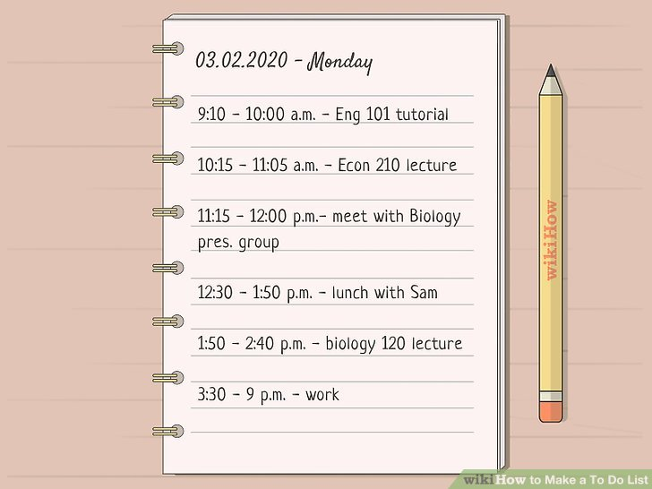

Example: to do list App
testuser
todo_item
todo_item_id | description | owner_id | priority_id | context_id | status_id | project_id | due_date | completion_date
integer
text
integer
integer
integer
integer
integer
date
date

Slide 8
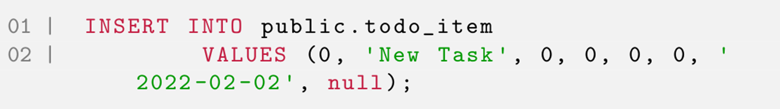
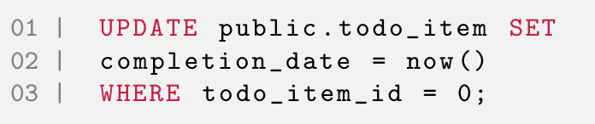
testuser
| CREATE ROLE testuser
| NOINHERIT LOGIN PASSWORD 'password';
01 | CREATE DATABASE todo_list
02 | WITH
03 | OWNER = testuser
04 | ENCODING = 'UTF8'
05 | CONNECTION LIMIT = -1;
01 | \ c todo_list testuser
CREATE TABLE public.todo_item
(
todo_item_id integer NOT NULL,
description text,
owner_id integer,
priority_id integer,
context_id integer,
status_id integer,
project_id integer,
due_date date,
completion_date date,
PRIMARY KEY (todo_item_id)
);

Slide 9
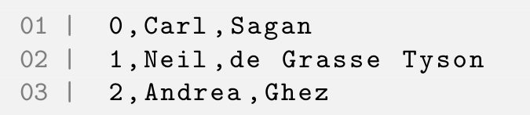
Comma separated file
There are a number of different formats we can use to store data in a raw file.
Another very common format is a comma-separated file:

Slide 10
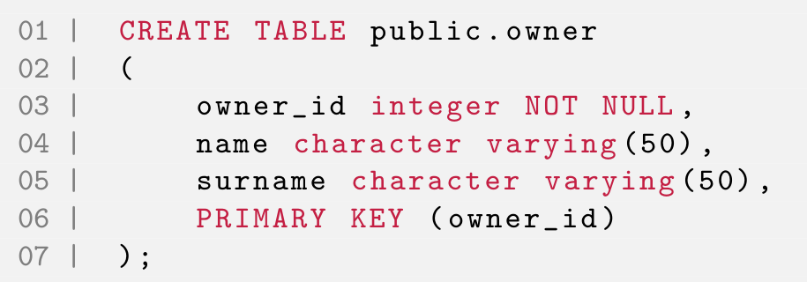
Import from csv - create table
To be able to import from a csv file we first need an empty table to import into.
Let’s create a new owner table. This will store data about the users of the program who will own various todo items.
owner_id | name | surname

Slide 11
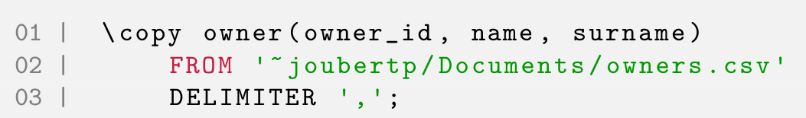
Import from csv - COPY command
Once we have a .csv file with data and an empty table to import the data into, we can use the COPY command to import the data:
We need to define the table we want to copy into, the exact file location where the .csv file is stored, and what character is used to separate values in the file (in this case a comma).

Slide 12
Outline (This Week)
Importing Data
Creating Constraints
SQL Functions
Views
Dynamic Queries

Slide 13
Constraints
We’ve only created a single type of constraint, the PRIMARY KEY constraint.
We’ve also only created a constraint when we create the table.
We’re now going to look at altering an exist table to include a constraint.

Slide 14
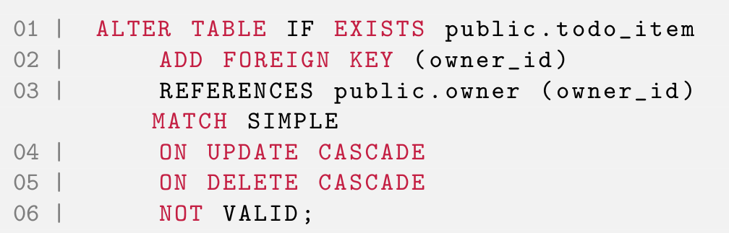
ALTER existing structure
We can alter the existing structure of a table using the ALTER command.
We are only adding a foreign key in this example but the ALTER command can be used to change almost any part of the structure of a table:
todo_item_id | description | owner_id | priority_id | context_id | status_id | project_id | due_date | completion_date
owner_id | name | surname
any changes we make in the foreign table will also change in the primary table
Will cause a scan of the table to verify that all existing rows in the table satisfy the new constraint. But if the NOT VALID option is used, this potentially-lengthy scan is skipped. The constraint will still be enforced against subsequent inserts or updates

Slide 15
When to create Foreign Key Relationships
Most of the time it makes more sense to design as much of your database, in as much detail as possible before you implement it.
In this way you can define the Relationships when you create the Table, and not have to alter the table afterwards.
In our example we have already created our primary table (todo item), so we will just be altering this table going forward.

Slide 16
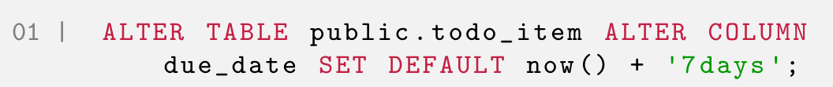
Default Constraint
We can also alter (or add when creating the database) a default constraint:
This constraint will make the default due date 7 days from the current date, if no due date is specified.

Slide 17

Checking existing constraints and relationships
We can check the relationships and constraints on a specific table using the \d command in psql.

Slide 18
Outline (This Week)
Importing Data
Creating Constraints
SQL Functions
Views
Dynamic Queries

Slide 19
Functions
There are a number of SQL functions that we can use to perform additional analysis on the data that we query using the select statement.
All of these functions return either additional information, (e.g. the Sum() function), or they format the result of the query in some way (e.g. the SORT command)

Slide 20
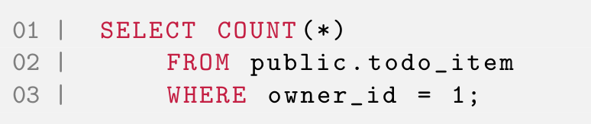
Count()
todo_item_id | description | owner_id | priority_id | context_id | status_id | project_id | due_date | completion_date
How many todo items belong to a particular owner?
We can use the Count() function to return the number of rows a specific query returns:

Slide 21
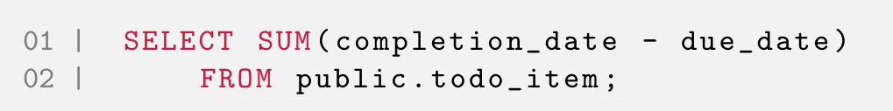
Sum()
todo_item_id | description | owner_id | priority_id | context_id | status_id | project_id | due_date | completion_date
Total number of days all tasks currently in the todo item table took to complete?
The Sum() function returns the SUM of all the numeric values in the selected columns:
This query returns the total number of days all tasks currently in the todo item table took to complete.
We actual perform a subtraction on each row (to get the number of days a single task took), and then use the Sum() function to add all those individual durations together.

Slide 22
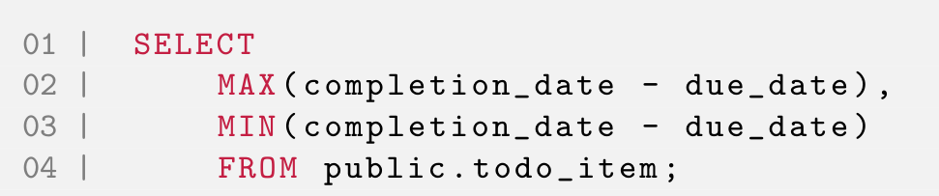
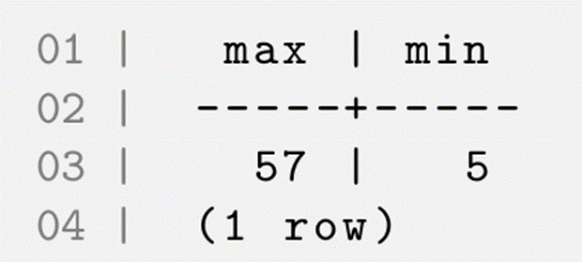
Min() and Max()
todo_item_id | description | owner_id | priority_id | context_id | status_id | project_id | due_date | completion_date
It would be more interesting to see what the minimum and maximum number of days a task took would be:
Note that we can include multiple different functions in a single SELECT.

Slide 23
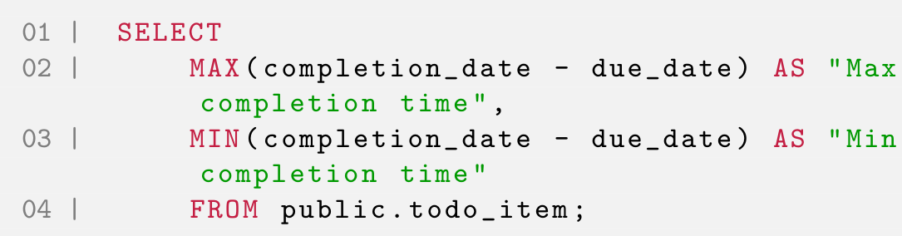
The AS Command
The AS command renames the column in a result.
This is useful if we need to make our results more clear
Updating our previous query to include the AS command looks as follows:
Note the use of the double quotes when defining the column name, instead of the single quote when defining a string literal.

Slide 24
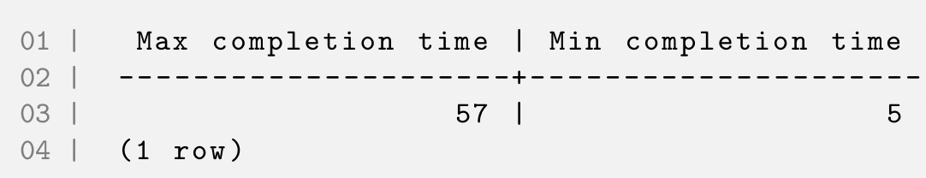
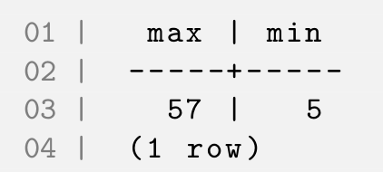
AS Result
The result from the previous would now look as follows:
Remember also that the renamed column will also be sent to any programming code that is running this querying, which can make presenting the result in an application much easier.

Slide 25
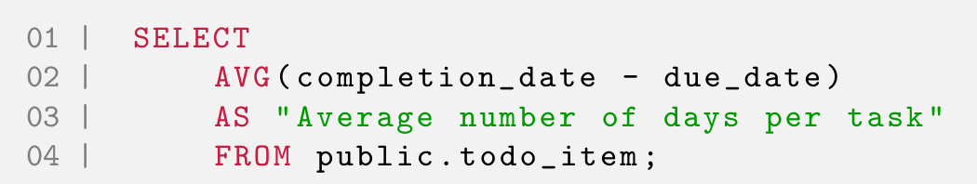
Avg()
todo_item_id | description | owner_id | priority_id | context_id | status_id | project_id | due_date | completion_date
Another useful way to examine the todo item table might be in the context of the average number of days a tasks takes:
HINT: You can use the Round() function to round off the number of days to a more readable format.

Slide 26
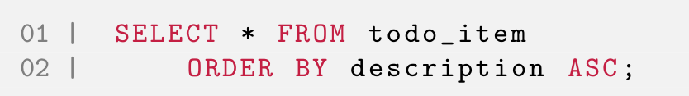
ORDER BY ASC and DESC
A critical part of presenting queried data is Sorting it in a useful manner.
We can sort (or order) our results by a specific column, either in ascending or descending order:
We can change whether to order in ascending or descending order by using the ASC or DESC command.

Slide 27
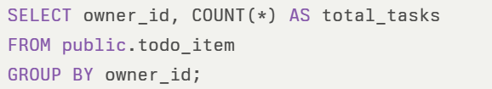
Group by
The GROUP BY clause lets you group rows with the same value into summary rows, often combined with aggregate functions like COUNT, SUM, AVG, etc..​
Example: Find out how many tasks are assigned to each owner in a to-do list.
owner_id | total_tasks
1 | 3
2 | 2
3 | 1
Notes:
The GROUP BY clause lets you group rows with the same value into summary rows, often combined with aggregate functions like COUNT, SUM, AVG, etc..​
Example: Find out how many tasks are assigned to each owner in a to-do list.

Slide 28
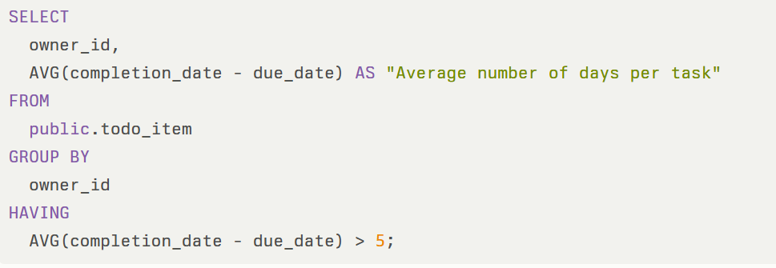
Having query
Purpose of HAVING:
The HAVING clause is used to filter results after grouping and aggregation (e.g., AVG, SUM, COUNT). It acts like a WHERE clause but for grouped rows.
owner_id | Average number of days per task
2 | 7.3
5 | 9.8

Slide 29
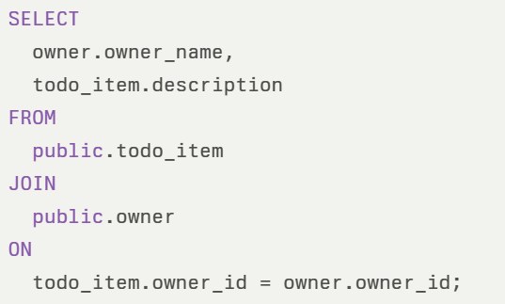
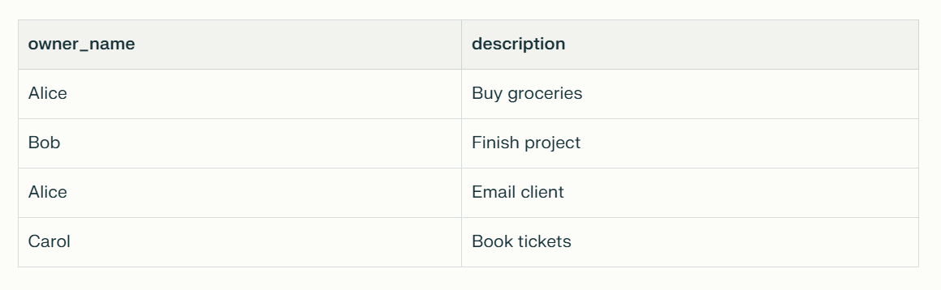
Join command
Purpose:
A JOIN lets you combine related data from two tables into one result.
Useful for linking tasks to their owners in a todo application.
Example Tables
todo_item: Stores tasks — fields: task_id, owner_id, description, completion_date, due_date
owner: Stores owner details — fields: owner_id, owner_name
Example Query: List Each Owner's Task Description

Slide 30
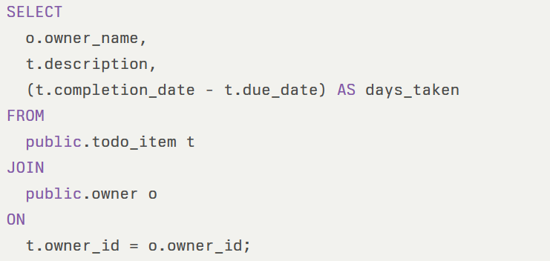
Join Command
owner_id | owner_name
1 | Alice Johnson
2 | Bob Smith
3 | Carol Lee
4 | David Brown
task_id | owner_id | description | completion_date | due_date
101 | 1 | Prepare report | 2025-10-12 | 2025-10-09
102 | 2 | Update website | 2025-10-10 | 2025-10-08
103 | 1 | Submit tax file | 2025-10-14 | 2025-10-10
104 | 3 | Team meeting | 2025-10-07 | 2025-10-06
105 | 2 | Client communication | 2025-10-15 | 2025-10-10
106 | 4 | Design presentation | 2025-10-08 | 2025-10-08
107 | 1 | Check invoices | 2025-10-16 | 2025-10-10

Slide 31
Join result
owner_name | description | days_taken
Alice Johnson | Prepare report | 3
Bob Smith | Update website | 2
Alice Johnson | Submit tax file | 4
Carol Lee | Team meeting | 1
Bob Smith | Client communication | 5
David Brown | Design presentation | 0
Alice Johnson | Check invoices | 6

Slide 32
Outline (This Week)
Importing Data
Creating Constraints
SQL Functions
Views
Dynamic Queries

Slide 33
Creating a View
A view is just a temporary table created based on a query. By temporary we mean that no additional tables or database entities are created.
The view is created when the query is run and is readonly, because as the name implies, we only view this data.

Slide 34


Using a View
We can list all views that exists on a database using:
We use a view in exactly the same way we would use any other table:

Slide 35
Outline (This Week)
Importing Data
Creating Constraints
SQL Functions
Views
Dynamic Queries

Slide 36
Dynamic Queries
Occasionally we don’t know exactly what values we are going to be using within a query. Most often this will come from an external program (e.g. a JavaFX UI).
In this case we prepare a query or statement beforehand and use it later on. (This is why dynamic queries are also known as Prepared Statements).
We just need to define which parts of our query will be parameters and not hardcoded.

Slide 37
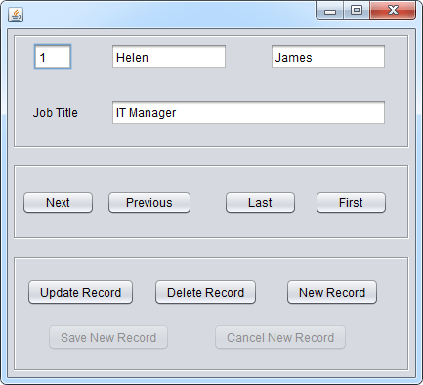
In some cases, however, the SQL statements are composed at run time or provided by an external source.

Slide 38
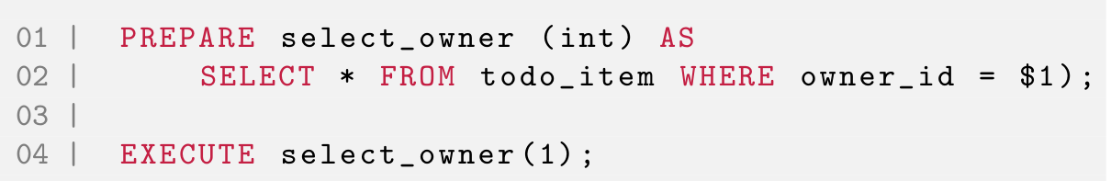
Dynamic Queries Example
we create a prepare SELECT statement and EXECUTE it with
a parameter.

Slide 39

DROP
While we are developing a database, we might fill it with some temporary or test data. It is critically important to remove this data once the structure is finalised, both for reasons of security and data integrity.
Occasionally we want to completely remove an existing table (or database). In this case we use the DROP command.
Be careful when using the DROP command as that will completely remove whatever database structures you set, as well as all data that was stored in that structure.

Slide 40
TRUNCATE
More often we would prefer to keep the database structure, but remove all the data in the database. In this case we can use the TRUNCATE command:
In general we prefer to use DELETE when we need to remove a subset of rows from a table. DELETE performs the remove row-by-row, so TRUNCATE will be much faster than DELETE for removing all the rows from a table.

Slide 41
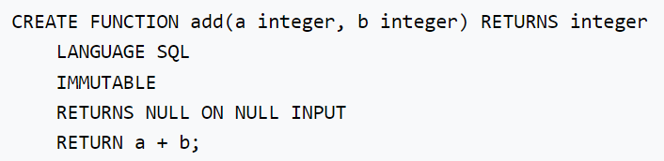
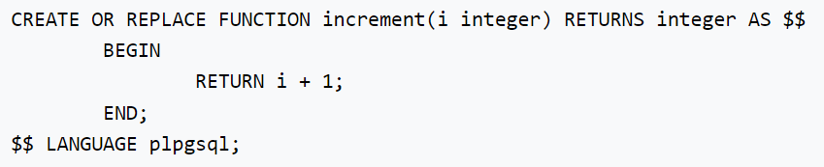
Using Control Structures
Self study
Stored procedures
1. Returning from a Function
2. Returning from a Procedure
3. Calling a Procedure
4. Conditionals
5. Simple Loops
6. Looping through Query Results
7. Looping through Arrays
…
For more info: https://www.postgresql.org/docs/current/plpgsql-control-structures.html

Slide 42
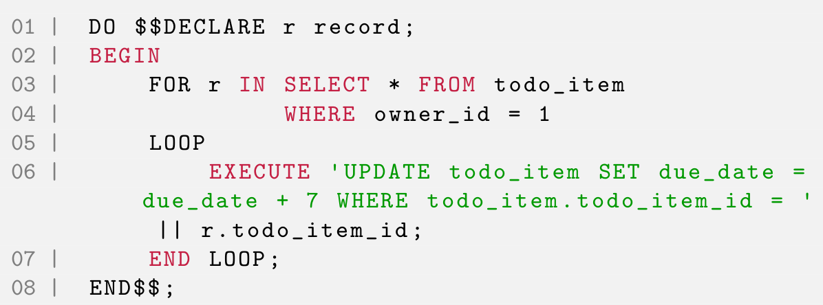
DO blocks
Execute an anonymous code block.
The code block is treated as though it were the body of a function with no parameters, returning void. It is parsed and executed a single time.
There is no DO statement in the SQL standard.
selects all items with a specific owner id and
then updates the due date for all of those items:

Slide 43
Summary
Importing Data
Creating Constraints
SQL Functions
Views
Dynamic Queries

Slide 44
This week Week 4 - Example class test

Slide 45
Next week Week 5 – Class test

